Slide 1

Signal Processing Assignment 2025
Justin Pesesse

Slide 2
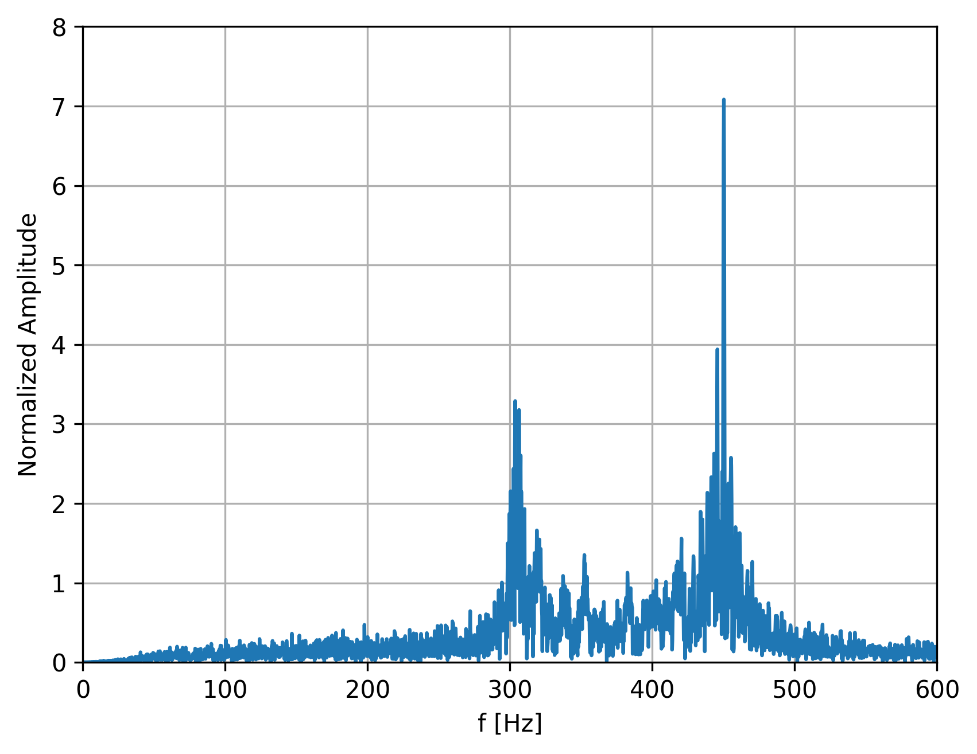
Vortex shedding region spectrum
Probe location: X = 19.444 mm, Y = 9.0254 mm
A Fast Fourier Transform (FFT) is applied to the velocity magnitude using the NumPy FFT library. The FFT is then normalized by the square root of the number of samples.
To enhance spectral visualization, a first-order Butterworth high-pass filter with a 100 Hz cut-off frequency is applied to remove low-frequency components. These low frequencies, despite their high amplitudes, are not relevant for analyzing vortex shedding.
Two dominant vortex shedding frequencies are identified at approximately 300 Hz and 450 Hz, corresponding to the primary frequencies associated with the two stationary conditions.

Slide 3
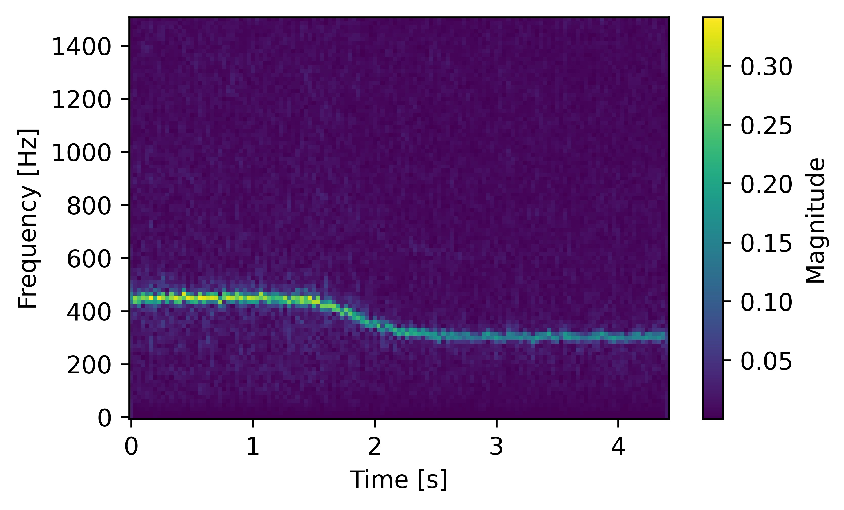
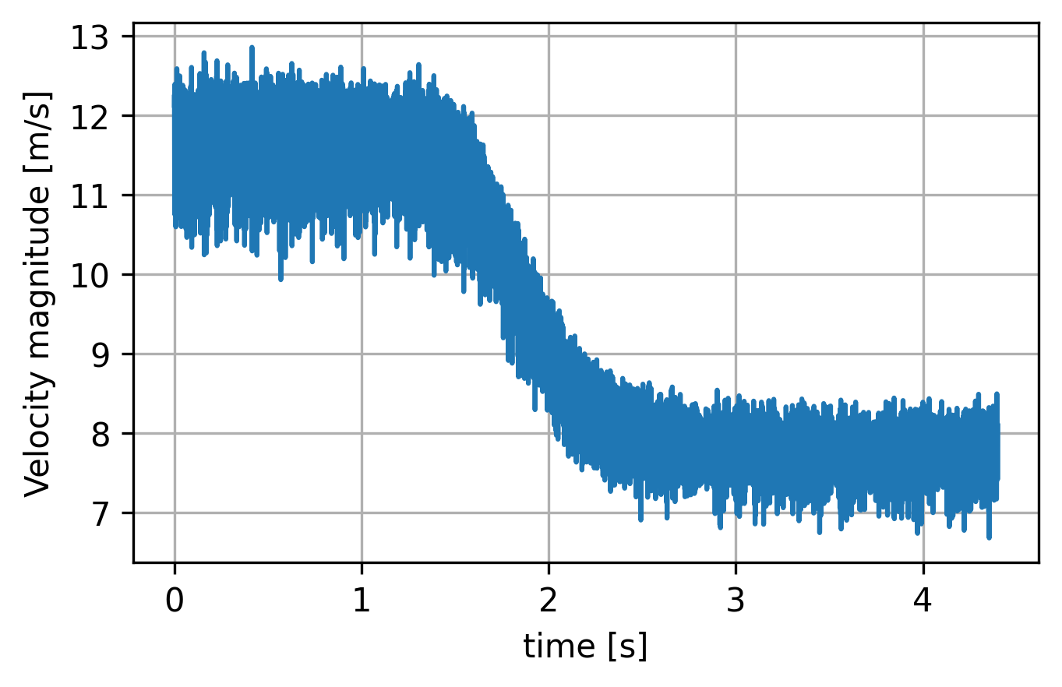
Time-frequency analysis
The Short-Time Fourier Transform (STFT) can be computed very easily by using the Numpy library STFT. To get this plot, a Hann window was used.
The Short-Time Fourier Transform (STFT) is a powerful method for identifying the primary frequencies in a signal and analyzing how they evolve over time.
As observed, the vortex shedding at 450 Hz dominates the signal during the first 1.5 seconds, after which the 300 Hz frequency becomes the dominant component.
Therefore it can be deduced that the 450 Hz vortex shedding frequency corresponds to a velocity magnitude of 11.5 m/s, while the 300 Hz shedding frequency aligns with a velocity of 8 m/s.

Slide 4
Multi-Resolution Analysis
Multiresolution Analysis (MRA) is a powerful tool in signal processing used to decompose a signal into different scales. In this exercise, three scales were analyzed: the freestream velocity scale and the two distinct vortex shedding phenomenon scales.
In this animation, the range of frequencies analyzed is from 0 to 15 Hz, chosen to emphasize the freestream velocity in the signal.
As observed, after 1.5 seconds, the freestream velocity decreases from 11.5 m/s to 8 m/s, aligning with the previous figure depicting the velocity magnitude.

Slide 5
Multi-Resolution Analysis
This animation represents the second scale studied, corresponding to the 300 Hz vortex shedding velocity in the signal. As observed, the vortices become visible after 1.5 seconds, aligning with the time-frequency analysis.
Finally, this animation represents the third scale, corresponding to the 450 Hz vortex shedding velocity in the signal. As observed, the vortices are visible from the start but disappear after 1.5 seconds when the freestream velocity decreases, allowing the 300 Hz vortex shedding to take over.

